Slide 1
Bitcoin 101
An introduction to bitcoin & cryptocurrencies by: Gilly Barr

Slide 2
Boring things I think I should say
I am not a professional
I have a small cryptocurrency portfolio
Not affiliated with any company
Opinions are my own
Don’t take any information as advice

Slide 3
A long, long time ago...
Nick Szabo publishes “bit gold” - an idea for a system of a decentralized digital currency
Satoshi Nakamoto publishes the “bitcoin whitepaper”
Satoshi disappears
1998
10/2008
2010
2008
1/2009
The financial crisis of 2008
First bitcoin is mined (by Satoshi)
Notes:
The idea of a digital currency existed for quite a while before bitcoin.
Cypherpunks - online community for ‘hackers’, ‘libertarians’, etc…
Nick Szabo wrote an article for bit gold.
Satoshi mined the first 1M bitcoins until the first transaction to Hal Finney

Slide 4
Creating a digital currency
Bitcoin was not the first attempt at a digital cryptocurrency, but it was the first to solve two major problems.
Digital Scarcity How are coins created and at what rate
Double spend attack Making sure coins are only spent once
Notes:
We will go into these subjects in depth soon...

Slide 5
The goals of bitcoin
Fully distributed (public ledger - decentralized)
Not based on trust
No middleman (a.k.a. bookkeeper/bank system)
Privacy (pseudonymity - transactions are public, identities are private)

Slide 6
Prerequisites
Cryptographic Hash Functions
evenly distributed
no way of reversing
there’s no way to find a specific hash except for randomly trying
Digital Signatures
Public Key & Private Key
Consists of 3 methods:
GeneratePublicKey()
SignMessage()
VerifyMessage()
Notes:
You must understand these two concepts to understand Bitcoin.
Hash functions
There’s no pattern (if there was, it would be hacked)
No way of reversing
Digital Signatures
Private key is chosen by user (or just randomly)
Public key is derived from the private key (but one-way)

Slide 7
The Blockchain
Bitcoin stores all transactions that ever happened on a fully public data-structure called a blockchain.
A blockchain is “just” a linked-list, but with hash pointers (instead of regular pointers)
Genesis Block
{ transactions… }
{ transactions… }
{ transactions… }
prevBlock
prevBlock
prevBlock
prevBlockHash
prevBlockHash
prevBlockHash
Notes:
The blockchain is the public list of transactions that all nodes can see and validate.
Every single transaction ever made is on the blockchain forever.
“Genesis Block” is just the name given to the first block in the chain

Slide 8
The Blockchain
At the moment (12/2018) :
There are 553,450 blocks on the blockchain
Each block holds anywhere from 500 to a few thousand transactions (blocks are limited by size, not by # of transactions)
Every ~10 minutes a new block is created
Notes:
Block rate is adjusted once every two weeks, so it will average out to once every 10 min.

Slide 9
The Blockchain
Nodes (a.k.a. computers/servers) can connect to the system at any point and disconnect from the system at any point.
Each node holds a copy of the blockchain (or just the headers of it)
All nodes in the system are constantly validating the ‘blockchain’
Notes:
There’s no “main server” synchronising the nodes.

Slide 10
How does bitcoin solve ‘double spending’ ?
The consensus is to go with the longest chain, so even if two different blocks are created at the end of the chain, at some point the ‘longer’ chain will will.
This also means that one of the chains will have ‘cancelled’ blocks.
Genesis Block
{ transactions… }
{ transactions… }
{ transactions… }
prevBlock
prevBlock
prevBlock
prevBlockHash
prevBlockHash
prevBlockHash
{ transactions… }
prevBlock
prevBlockHash
Notes:
We need to realise that this means that a transaction can be ‘cancelled’ after it’s made.
This means, if you want to be really sure that the money is transferred, it’s not enough to see a block, you should wait for a few blocks after to make sure it won’t be cancelled.
The consensus is to wait 6 blocks.

Slide 11
Creating Transactions
Creating a transaction just means ‘writing’ it on the next block that’s created.
All (or at least most) of the nodes on the network are competing to solve “hash puzzles” - the first one to solve the puzzle gets to write the next block.
Solving these hash puzzles require a HUGE amount of computing power.
So why would anyone want to invest so much in maintaining this blockchain???
Notes:
Note: a transaction is created by a single party - you don’t need any confirmation from any other side.
It’s worth noting that this also means that if you transfer btc to the wrong address (or even an invalid address) then there’s no way of retrieving the lost coins

Slide 12


Slide 13
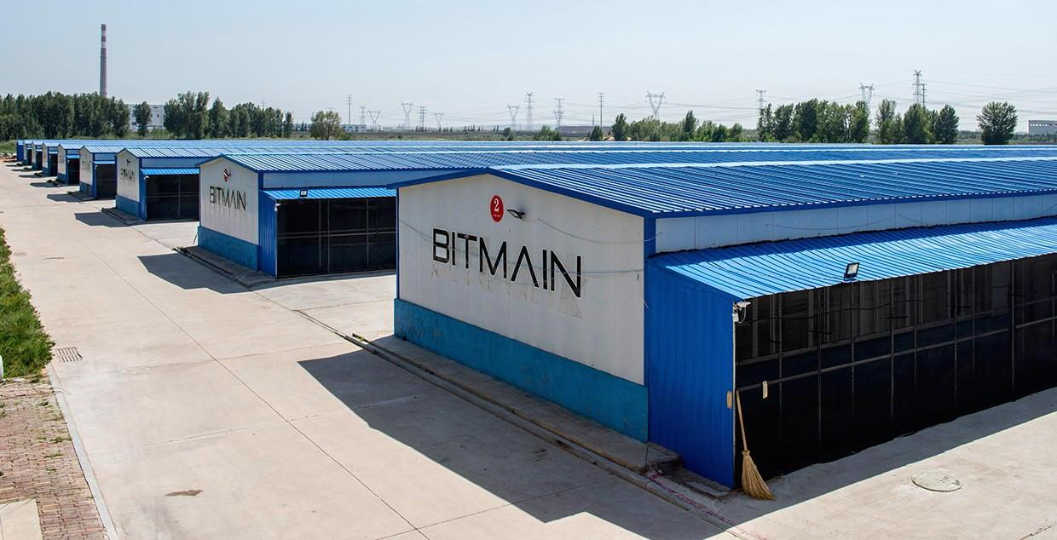
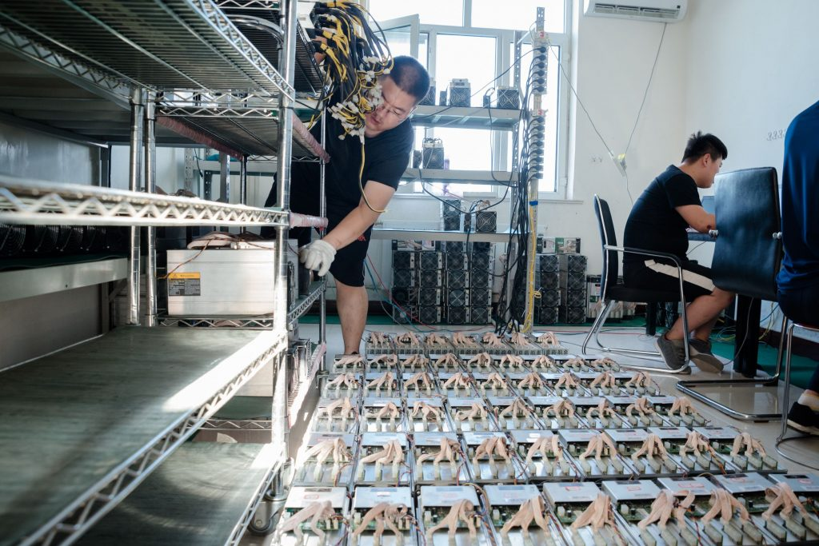
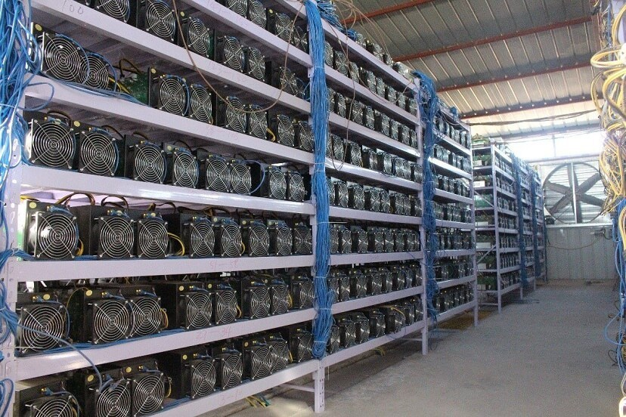
Just to get an idea…
Notes:
Bitmain hangars in China.
They are the largest bitcoin miner in the world.
They create specialized GPU’s intended for mining.

Slide 14
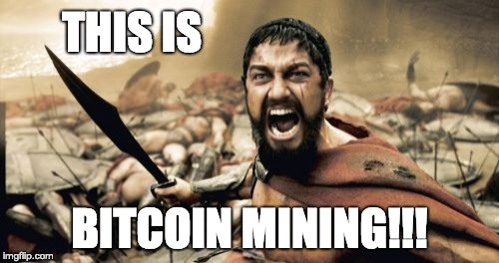

Slide 15
Bitcoin Mining
But wait…
How hard is it ?
How much can you earn ?

Slide 16
Solving hash puzzles
In order to ‘write’ the next block, you need to find a ‘nonce’ (number), so that when hashing the current block (the one you’re suggesting), the hash has a specifically defined prefix.
{ blockId: 556324234, transactions: [ A → B: 5BTC, C → D: 12BTC, ... ],
nonce: ???? }
SHA256()
00000005af876011ac8f…….
This defines the difficulty level
Notes:
Find a nonce, so that the hash produced has X number of zeros as a prefix.
Difficulty is automatically adjusted, so that it averages out to 1 block every 10 minutes.
Sometimes the ‘nonce’ field isn’t big enough to find a matching hash,
then you can change other parameters of the block: transaction fees, wallet addresses

Slide 17
Proof of Work
Solving these hash puzzles involves “work” (computing power)
Assuming the hash algorithms are good, there’s no way to find the next nonce, except for trying at random various combinations.
That means the chances you have of writing the next block on the chain are relative to the computing power of the whole network.

Slide 18
Mining reward
The first transaction in each block are the new coins being created. (The miner takes them to their own wallet).
In the beginning the mining reward was 50BTC for each block.
This halves every four years, until the year 2140 (21M coins)
We are currently at 12.5 BTC per block.

Slide 19
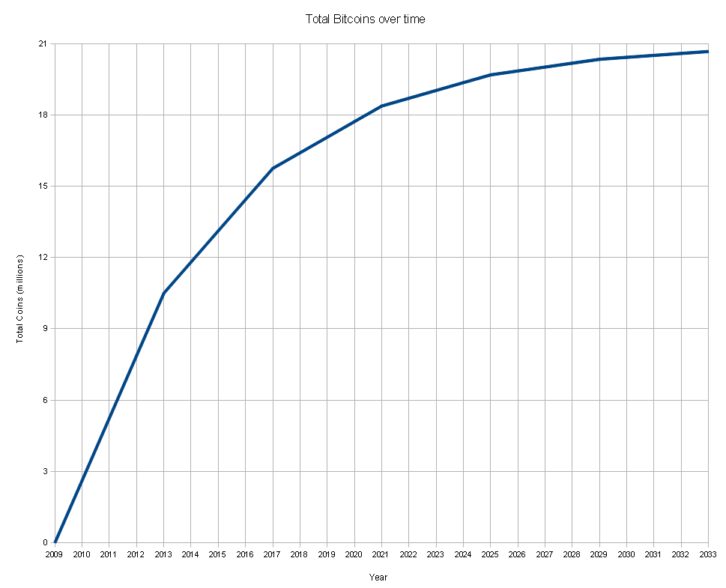
There will be a total of 21 Million coins (year: 2140)
Notes:
As time goes by, less coins are rewarded for hard work, so transaction fees will have to rise.
Currently it is pretty expensive, so it’s not worth transferring small amounts

Slide 20
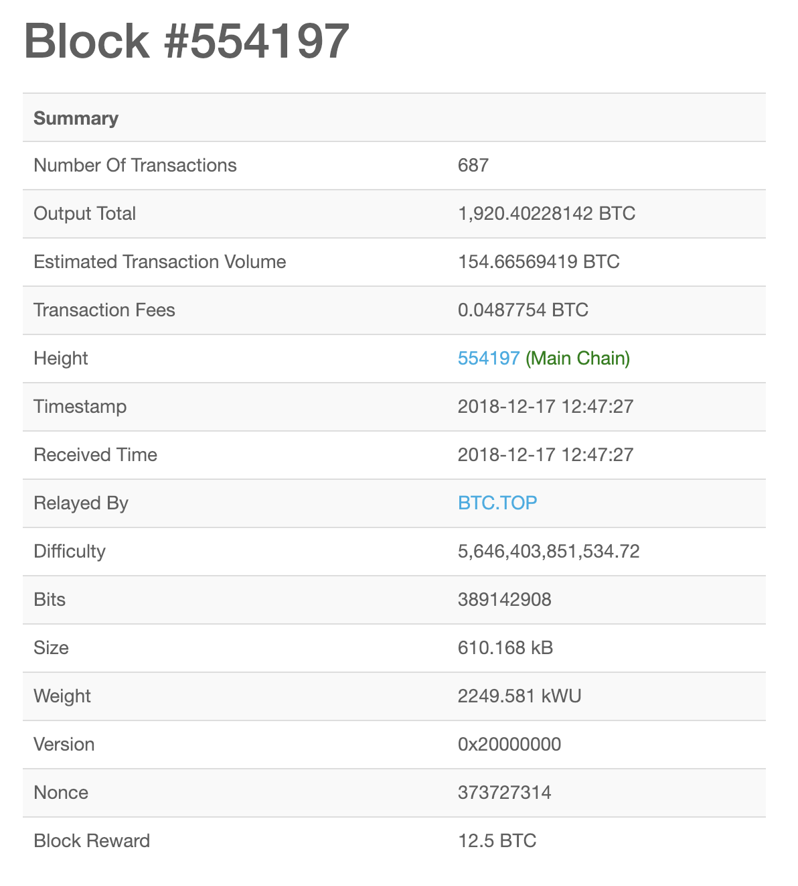
What does a real block look like ?
https://blockchain.info

Slide 21
Wallets
Randomly pick a 256bit number (private key):
Don’t show anyone that number! Hash it (ECDSA style), hash it again, and that’s your 160 byte (public key) wallet.
0x1
to
0xFFFF FFFF FFFF FFFF FFFF FFFF FFFF FFFE BAAE DCE6 AF48 A03B BFD2 5E8C D036 4140
Notes:
bitcoin uses the ECDSA private/public key standard. Then the public key is hashed again to create a 160 byte wallet.
wallet is base58 (so it’s easy to read in computer fonts)
There are 2^160 possible wallets in the world (~1,461,501,600,000,000,000,000,000,000,000,000,000,000,000,000,000)
You chances of finding a wallet with money in it are much less than winning the lottery.

Slide 22
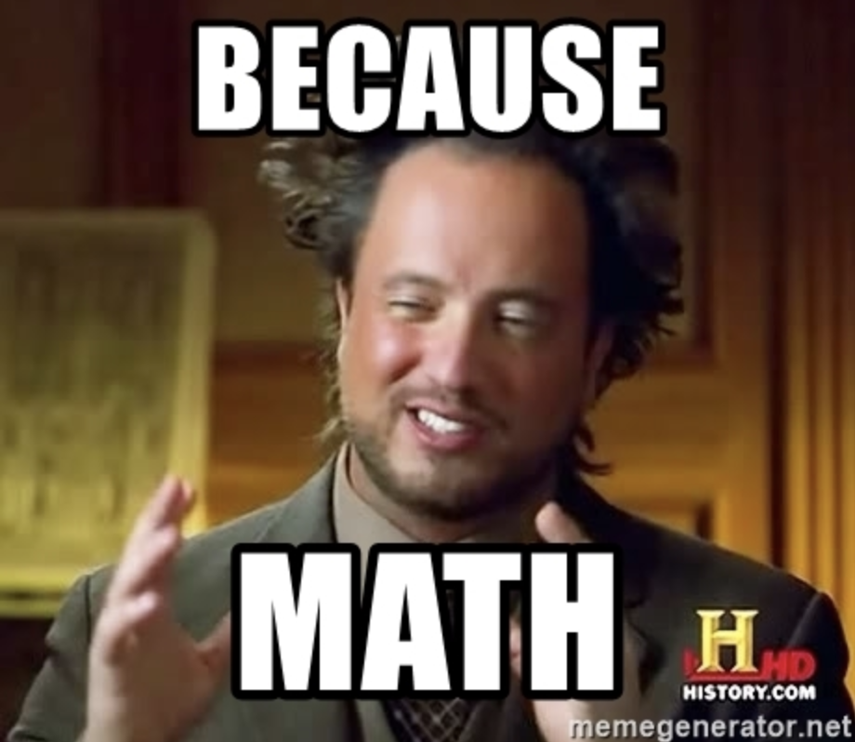
Wallets
All the possible wallets ‘exist’ already
Wallets aren’t really ‘created’, they are just ‘chosen’
So can someone just guess my wallet ?
No.
Why ? * https://www.reddit.com/comments/1rurll

Slide 23
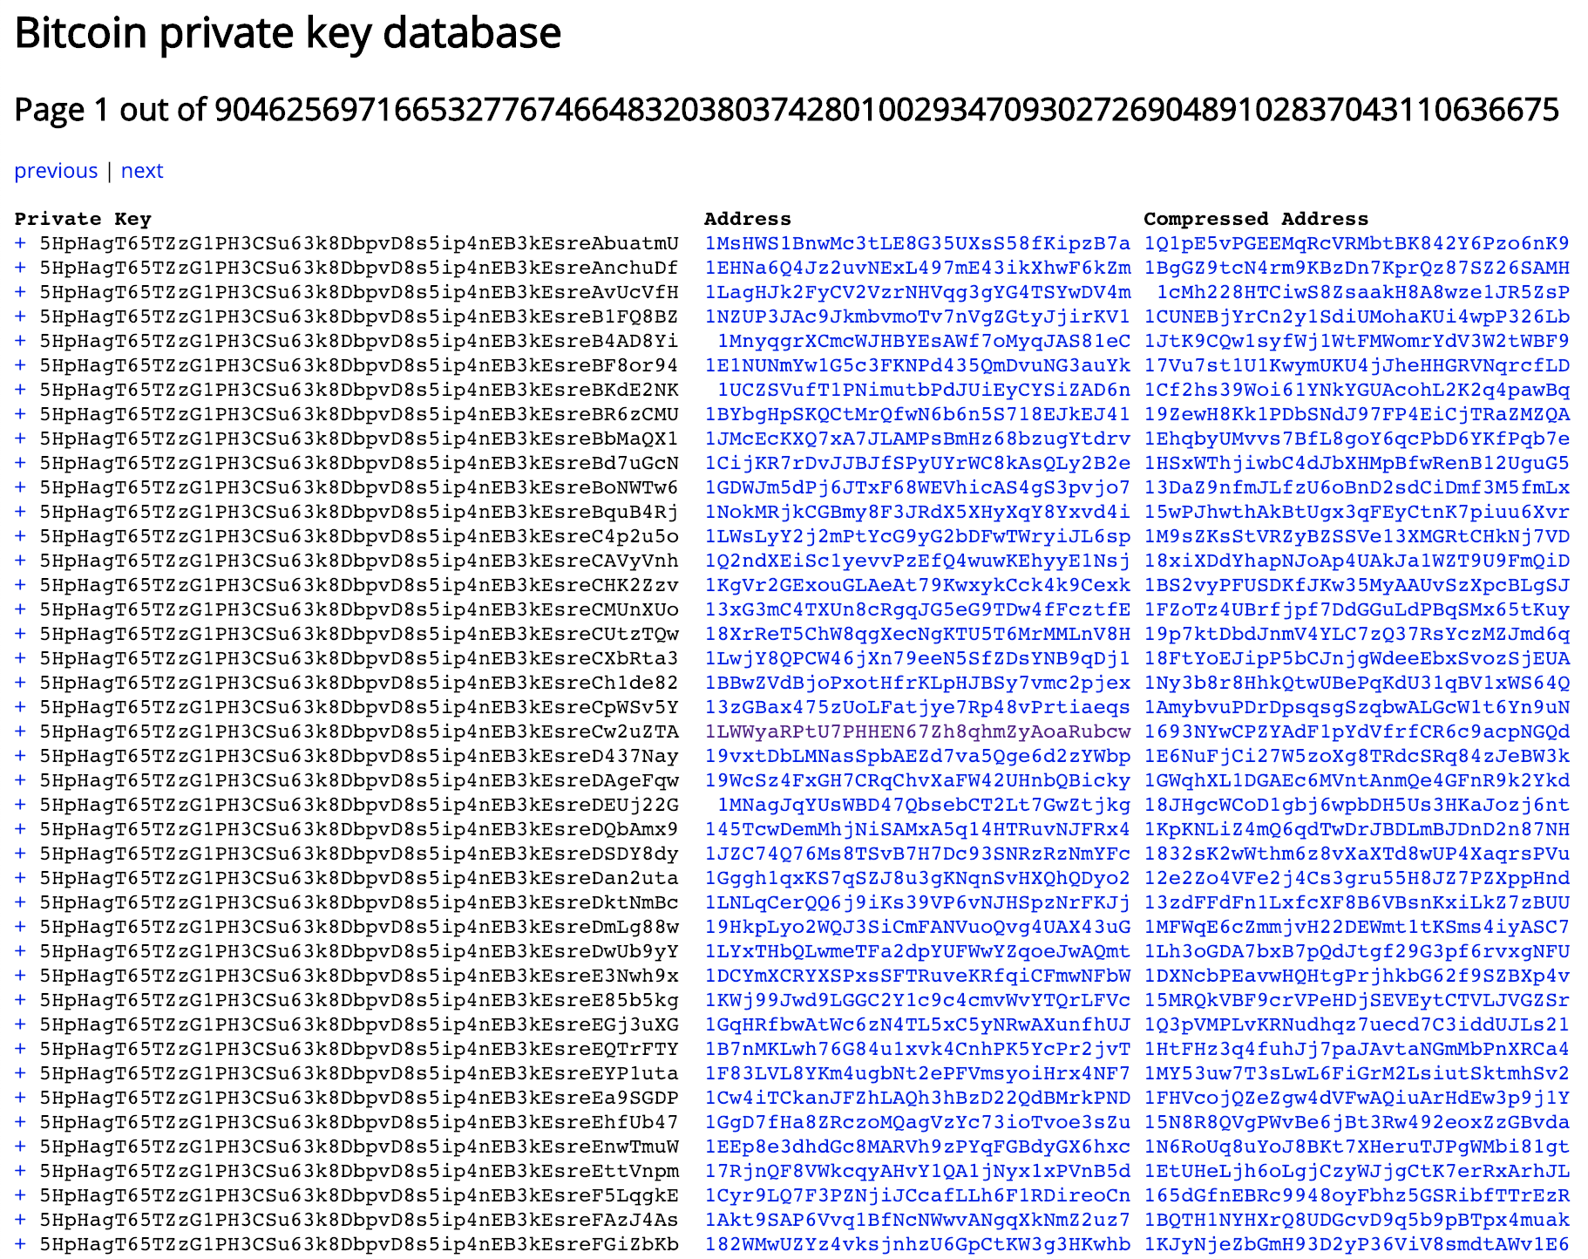

Slide 24
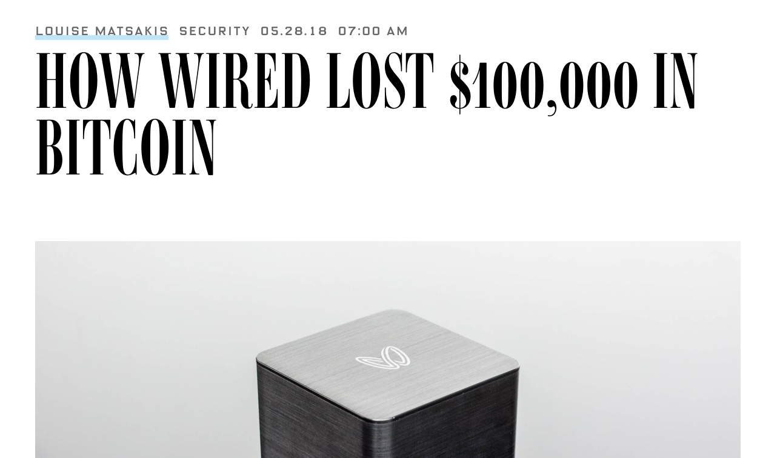
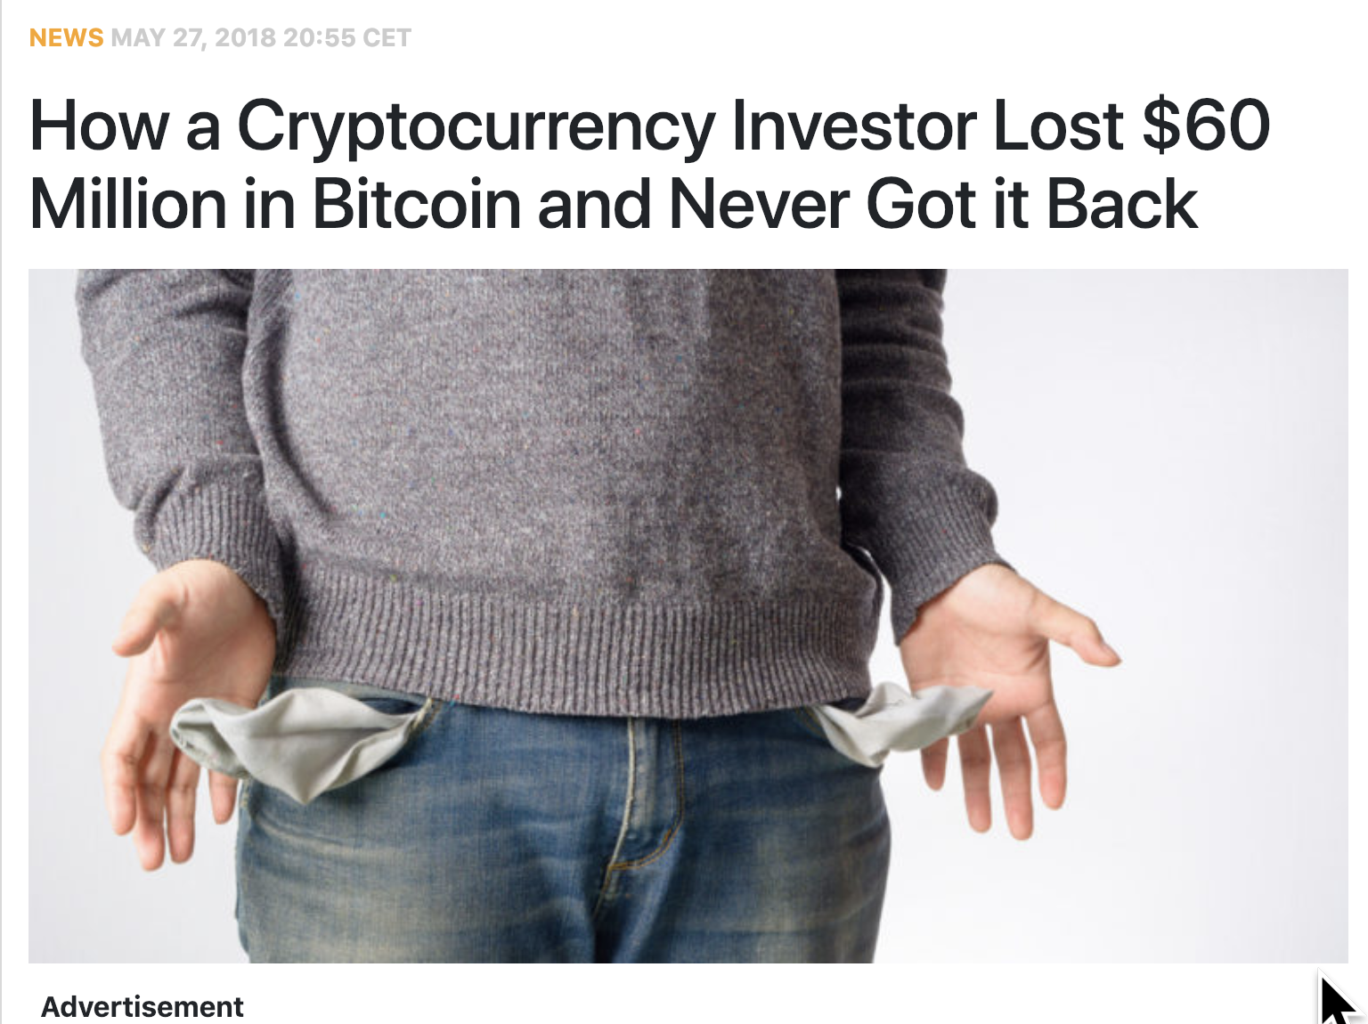
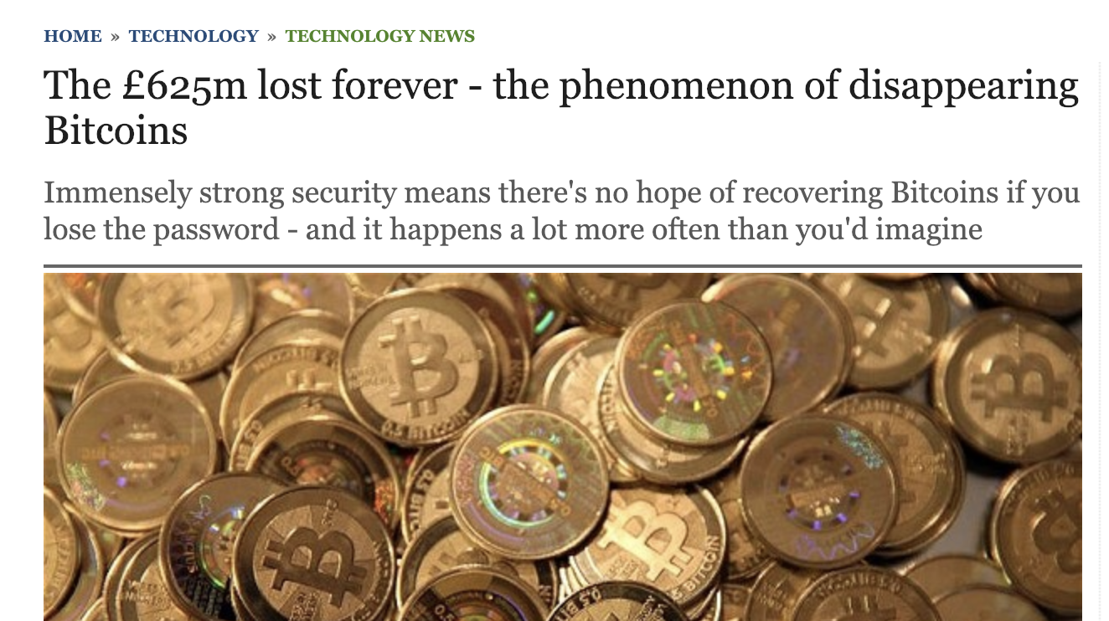
And sometimes this happens...
Notes:
Not even mentioning Satoshi Nakomoto - which apparently owns 1M BTC, and hasn’t moved them since 2009.

Slide 25
Losing bitcoins
There is no way to recover lost or stolen bitcoins. There is no way to recover lost or stolen bitcoins. There is no way to recover lost or stolen bitcoins.
Research suggests that somewhere between 20%-30% of all bitcoins mined until today, are lost.
Notes:
Because more bitcoin can’t be created, that means there can only be less and less active in the future

Slide 26
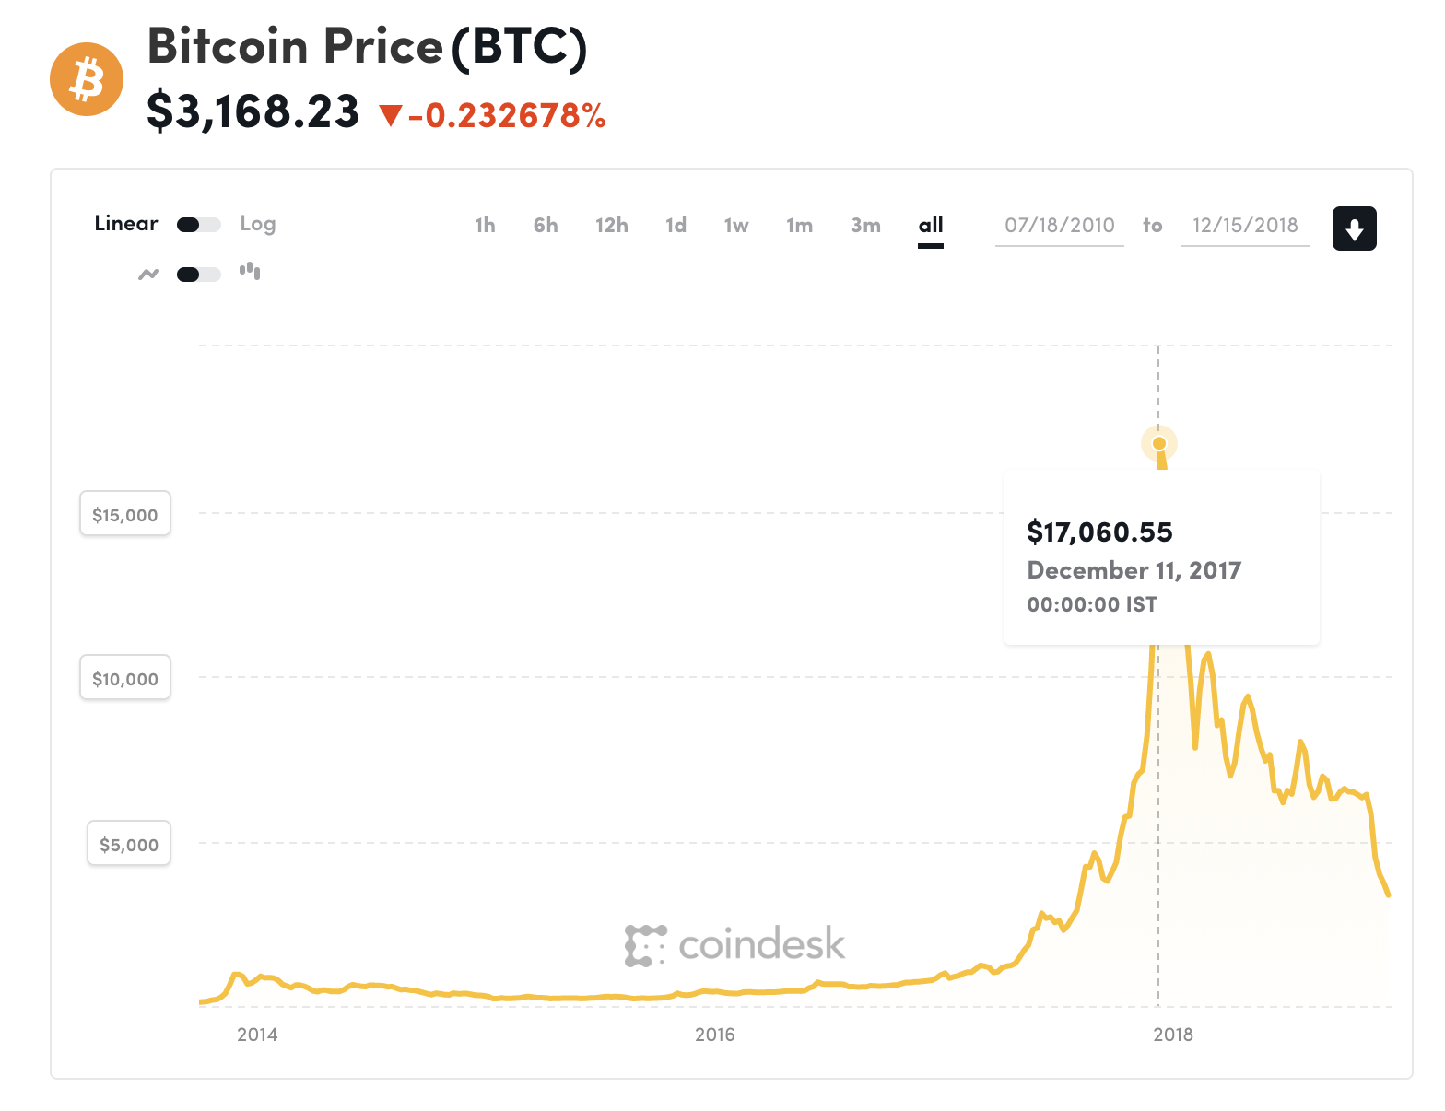
How much is 1BTC worth ?
Notes:
I think this is definitely not talked enough about!

Slide 27
The value of 1BTC
How is it measured ?
Supply & Demand… ?
How do you know how much supply there is ?
How do you know how much demand there is ?

Slide 28






Cryptocurrencies

Slide 29
Some conclusions (...or opinions ?)
Bitcoin and the whole concept of the blockchain is genius, from a theoretical CS standpoint. No doubt about that.
There are still many problems with the system
high transaction fees, that will only rise
slow rate of transactions
confirmations take a long time
no way of security (from getting robbed)
number of bitcoins will only go down
Notes:
or - Does bitcoin live up to it’s promise ?
Not really:
Still a few sources that do the mining (so only they can pass transactions)
Still the number of bad sources can outnumber the honest nodes one day

Slide 30
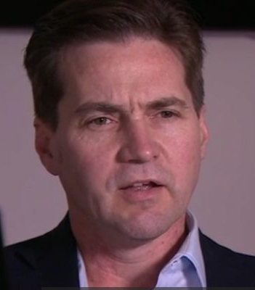
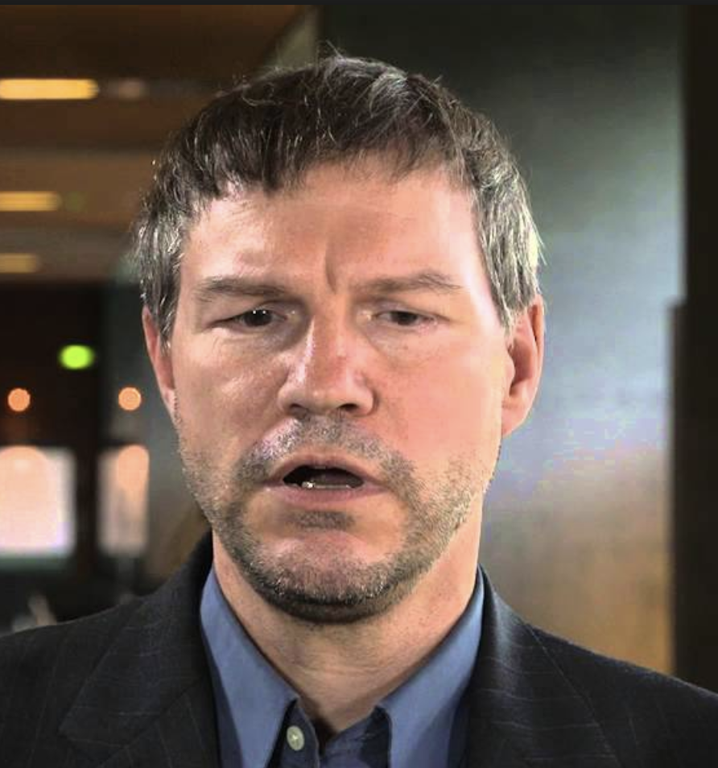
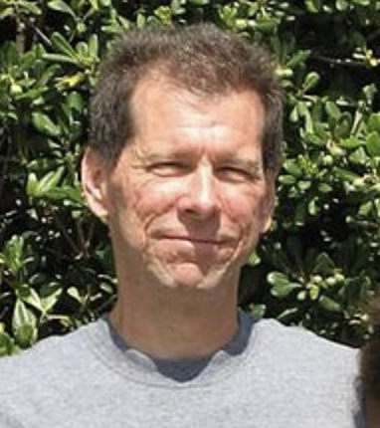
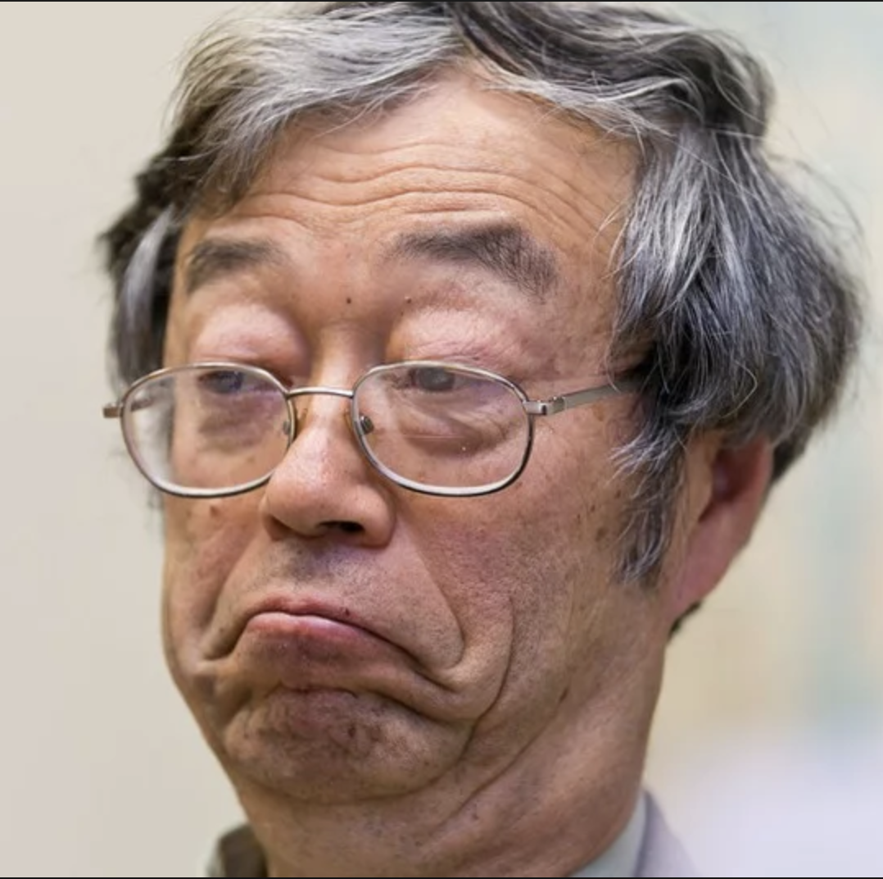
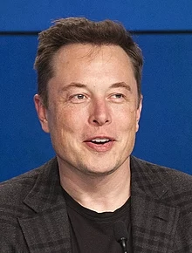
So who is Satoshi Nakamoto ?
No one really knows…
Everyone in the original “Cypherpunks” mailing list was asked by journalists, and all denied being him (except for Craig Wright, which no one believes!)
Researchers think it’s a team and not a single person.

Slide 31

Bits of Gold, bit2c

Slide 32
I’m interested...
Banking on Bitcoin - Netflix documentary
Bitcoin & Cryptocurrency Technologies - Princeton University course on Coursera
Satoshi’s white paper
CoinDesk - News site for crypto. Also has lots of articles explaining concepts.
Blockchain - Blockchain explorer
Beyond the Bitcoin Bubble - Recommended NYT article
Bitcoin source code

